Slide 1
Design Workshop
NKP Design Workshop

Slide 2
[Remove slide]
Instructions
Internal instructions: This slide deck is meant to cover all 3 product editions of NKP - Ultimate, Pro and Starter). Remove the slides, as indicated, that do not apply to the NKP edition associated with the engagement. Also remove any bracketed & yellow highlighted text from slides to remain.

Slide 3
[Remove slide]
Instructions
Internal instructions: Note that an NKP service offering relates to an NKP product edition.
NKP essential offering relates to the NKP starter product edition.
NKP advanced offering relates to the NKP pro product edition.
NKP enterprise offering relates to the NKP ultimate product edition.

Slide 4
Agenda
1
Intro & Offering Review
2
Open-Source Platforms
3
NKP Overview
4
NKP Requirements
5
Solution Requirements Discovery
6
Solution Design
7
References
NKP Design Workshop | Confidential
Notes:
Provide a brief overview of each of the agenda items to be covered as a part of the NKP design workshop:
Open-Source Platforms – covers a history of the need for & rise for containers, as well as overview of K8s – if client has experience with containers & Kubernetes, this can be skipped over if so desired
NKP Overview – covers NKP editions & their features, components
NKP Requirements – covers NKP pre-reqs, SW & HW reqs
Solution Requirements Discovery – reviews client’s current environment, business & technical requirements, workloads to be deployed, etc.
Solution Design – make initial decisions, where applicable, concerning product architecture, scaling & configuration
References – links to pertinent sites

Slide 5
Introductions & Service Offering Review
NKP Design Workshop | Confidential
Notes:
This section covers the various NKP product editions & their features, NKP components

Slide 6
Team Intros
Nutanix Team
PM Intro
Architect Intro
Sales/Services Sales Intro(s)
Client Team
PM Intro
Technical Team Intro(s)
Stakeholder Intro(s)
Notes:
Each member of the team that is present should introduce themselves, providing their title, project responsibility and relevant background

Slide 7
NKP Service Offering Review
[Remove slide if not NKP Essential Offering]
NKP Essential Edition Design Workshop
•Geared towards NKP Starter product edition
•Gather solution requirements and use cases
•Develop NKP architecture: deployment methodology, configuration, resource requirements for basic NKP implementation
•Delivery of a solution design doc & configuration workbook
•Estimated Nutanix LOE is 3 days
Notes:
Review, at a high level, the overall objectives of the service offering. Confirm the correct NKP service offering & product editions are in play. Confirm what is provided in the SOW contract matches the client’s expectations. Provide estimated LOE for delivering the workshop (including documentation related deliverables). Any scope misunderstandings or desired additions will need to be noted and then addressed by the PM, as appropriate (e.g. through a work order change).

Slide 8
NKP Service Offering
[Remove slide if not NKP Advanced Offering]
NKP Advanced Edition Design Workshop
•Geared towards NKP Pro product edition
•Gather solution requirements and use cases
•Develop NKP architecture: deployment methodology, configuration, resource requirements for an NKP implementation based on desired infrastructure provisioner type and cluster node OS
•Includes GPU & NKP-based backup solution considerations
•Delivery of a solution design doc & configuration workbook
•Estimated Nutanix LOE is 4 days
Notes:
Review, at a high level, the overall objectives of the service offering. Confirm the correct NKP service offering & product editions are in play. Confirm what is provided in the SOW contract matches the client’s expectations. Provide estimated LOE for delivering the workshop (including documentation related deliverables). Any scope misunderstandings or desired additions will need to be noted and then addressed by the PM, as appropriate (e.g. through a work order change).

Slide 9
NKP Service Offering
[Remove slide if not NKP Enterprise Offering]
NKP Enterprise Edition Design Workshop
•Geared towards NKP Ultimate product edition
•Gather solution requirements and use cases
•Develop NKP architecture: deployment methodology, configuration, resource requirements for an NKP implementation based on desired infrastructure provisioner type and cluster node OS
•Includes multisite & multitenancy design
•Includes GPU, NKP-based backup & observability solution considerations
•Delivery of a solution design doc & configuration workbook
•Estimated Nutanix LOE is 5 days
Notes:
Review, at a high level, the overall objectives of the service offering. Confirm the correct NKP service offering & product editions are in play. Confirm what is provided in the SOW contract matches the client’s expectations. Provide estimated LOE for delivering the workshop (including documentation related deliverables). Any scope misunderstandings or desired additions will need to be noted and then addressed by the PM, as appropriate (e.g. through a work order change).

Slide 10
Open-Source Platforms
[Skip this entire section if client audience is familiar with containers & Kubernetes]
NKP Design Workshop | Confidential
Notes:
This section covers the evolution of software development platforms, what a container is, what Kubernetes (k8s) is and its components, their benefits

Slide 11


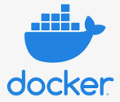









What is a Container?
[Skip this slide if client audience is familiar with containers]
“A container is a lightweight, executable unit of software that packs up application code and dependencies such as binary code, libraries, and configuration files for easy deployment across different computing environments”
Physical world
Hardware
Operating System
Application
VM world
Virtualized Hardware
Operating System
Application
Containers world
Virtualized Operating System
Application
Notes:
SKIP SLIDE IF AUDIENCE IS ALREADY A CONTAINER USER
A container is a standard unit of software that packages up applications’ code and all its dependencies – includes everything that is needed, nothing that isn’t (hopefully!) and consistency of configuration & deployment
A container can run on any system that has a container runtime – thus making it extremely portable

Slide 12
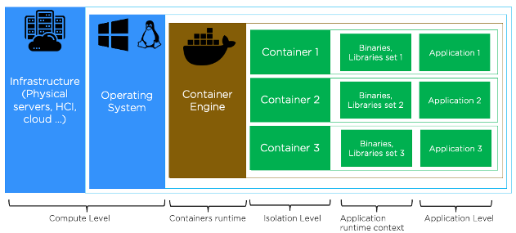
Applications on Containers
[Skip this slide if client audience is familiar with containers]

Slide 13
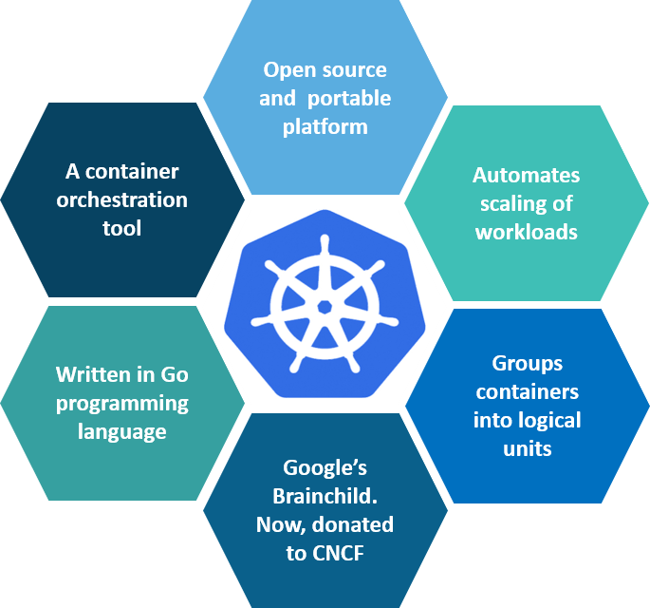
What is Kubernetes (K8S)?
“Kubernetes is a portable, extensible, open-source platform for managing containerized workloads and services, that facilitates both declarative configuration and automation”. (kubernetes.io)
Notes:
SKIP SLIDE IF AUDIENCE IS ALREADY A KUBERNETES USER
***Diagram courtesy of Edureka***
In short, Kubernetes provides container orchestration! It makes sure the actual container environment matches the desired container environment – is responsible for setting resource limitations on containers (if desired), determining where applications can be placed on nodes that are used to run containers based on system resource allocation, makes sure the containers that die are restarted, etc.

Slide 14
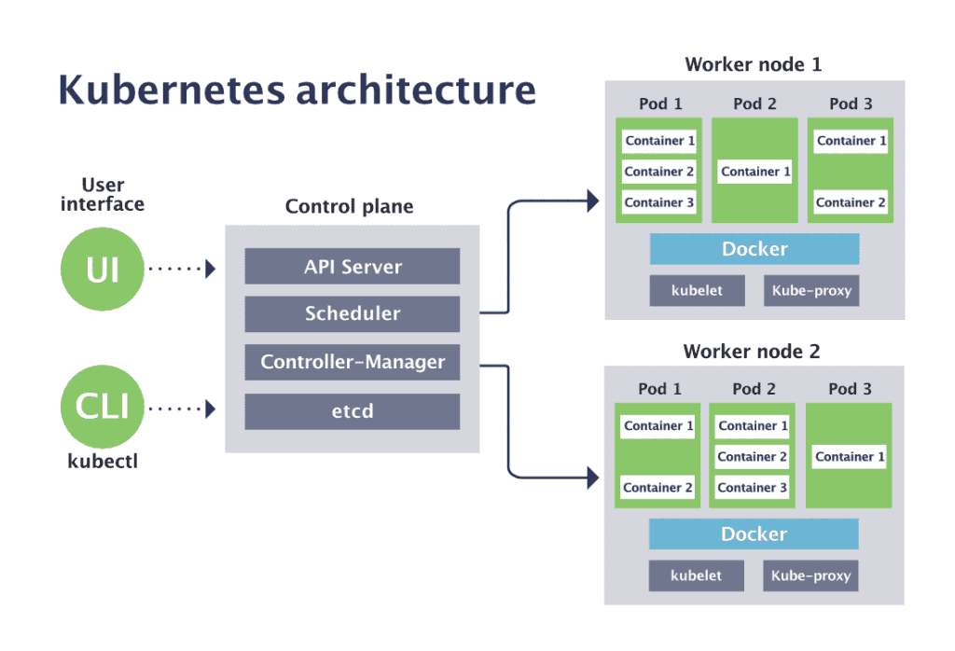
Kubernetes Components
[Skip this slide if client audience is familiar with K8s]
API server - Frontend for Kubernetes control plane (master nodes)
Scheduler - Makes scheduling decisions for newly created pods
Controller-manager – Runs controller processes
Etcd - Key value store for all cluster data
Worker Node - Runs containerized applications
Containerd - Container Runtime
Kubelet - Agent runs on each Node ensuring containers are running
Kube-proxy – Maintains network rules on pod
Pod - a group of one or more containers, with shared storage and network resources
Notes:
SKIP SLIDE IF AUDIENCE IS ALREADY A KUBERNETES USER
***Diagram courtesy of CNCF***
Control Plane Specific Components
Control Planes are the management tier of K8s
The control plane's components make global decisions about the cluster (for example, scheduling), as well as detecting and responding to cluster events (for example, starting up a new pod when a deployment's replicas field is unsatisfied).
Control plane components can be run on any machine in the cluster. However, for simplicity, set up scripts typically start all control plane components on the same machine, and do not run user containers on this machine. See Building High-Availability Clusters for an example multi-master-VM setup.
kube-apiserver
The API server is a component of the Kubernetes control plane that exposes the Kubernetes API. The API server is the front end for the Kubernetes control plane.
The main implementation of a Kubernetes API server is kube-apiserver. kube-apiserver is designed to scale horizontally—that is, it scales by deploying more instances. You can run several instances of kube-apiserver and balance traffic between those instances.
etcd
Consistent and highly-available key value store used as Kubernetes' backing store for all cluster data.
If your Kubernetes cluster uses etcd as its backing store, make sure you have a back up plan for those data.
You can find in-depth information about etcd in the official documentation.
kube-scheduler
Control plane component that watches for newly created Pods with no assigned node and selects a node for them to run on.
Factors taken into account for scheduling decisions include: individual and collective resource requirements, hardware/software/policy constraints, affinity and anti-affinity specifications, data locality, inter-workload interference, and deadlines.
kube-controller-manager
Control Plane component that runs controller processes.
Logically, each controller is a separate process, but to reduce complexity, they are all compiled into a single binary and run in a single process.
These controllers include:
Node controller: Responsible for noticing and responding when nodes go down.
Replication controller: Responsible for maintaining the correct number of pods for every replication controller object in the system.
Endpoints controller: Populates the Endpoints object (that is, joins Services & Pods).
Service Account & Token controllers: Create default accounts and API access tokens for new namespaces.
All K8s Node Components
Node components run on every node (control planes & workers), maintaining running pods and providing the Kubernetes runtime environment.
Worker nodes are responsible for running the applications, services, etc. that perform ‘work’ on the K8s cluster
kubelet
An agent that runs on each node in the cluster. It makes sure that containers are running in a Pod .
The kubelet takes a set of Pod specs that are provided through various mechanisms and ensures that the containers described in those Pod specs are running and healthy. The kubelet doesn’t manage containers which were not created by Kubernetes.
kube-proxy
kube-proxy is a network proxy that runs on each node in your cluster, implementing part of the Kubernetes Service concept.
kube-proxy maintains network rules on nodes. These network rules allow network communication to your Pods from network sessions inside or outside of your cluster.
kube-proxy uses the operating system packet filtering layer if there is one and it's available. Otherwise, kube-proxy forwards the traffic itself.
Container runtime
The container runtime is the software that is responsible for running containers.
Kubernetes supports several container runtimes: Docker , containerd , CRI-O , and any implementation of the Kubernetes CRI (Container Runtime Interface).
What Is containerd?
Containerd is a Docker-developed container runtime that manages the life cycle of a container on a physical or virtual machine (i.e., a host). It creates, starts, stops, and destroys containers. It can also pull container images from container registries, mount storage, and enable networking for a container.
In February 2019, containerd became an official project within the Cloud Native Computing Foundation (CNCF), just as Kubernetes, Prometheus, Envoy, and CoreDNS have.
Kubernetes offers an efficient means for container management that's great for high-demand applications with complex configuration

Slide 15
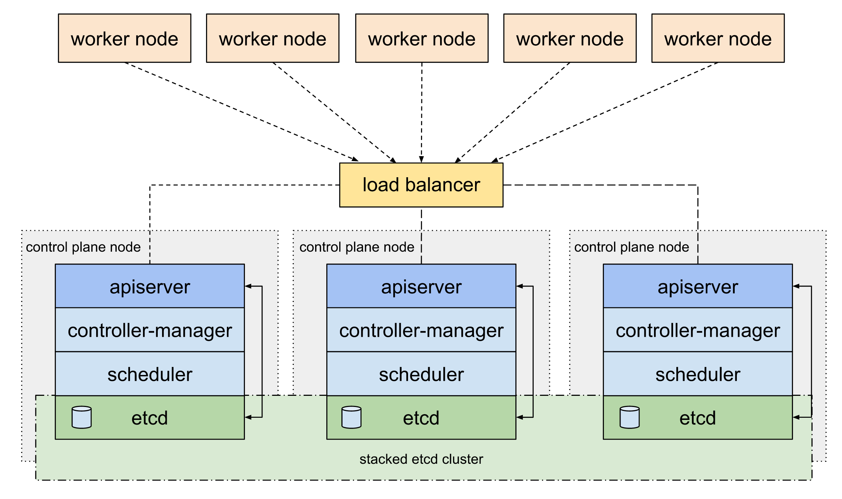
Kubernetes High-Level Architecture/HA
[Skip this slide if client audience is familiar with K8s]
https://kubernetes.io/docs/setup/production-environment/tools/kubeadm/ha-topology/
Notes:
SKIP SLIDE IF AUDIENCE IS ALREADY A KUBERNETES USER
Control Plane (Management) Tier
Control Planes provide orchestration/management of containers
Control Plane HA is achieved through multiple Control Planes Nodes utilizing a load-balancer via port 6443 for the kube-apiserver)
Control Planes should be deployed in ‘odd’ numbers as they perform an internal election process to determine a leader (even number can lead to a ‘split brain’ vote where no leader election occurs)
Multiple control plane nodes do NOT provide scalability, just redundancy – that is why it is recommended that cluster workloads only be performed on Worker nodes
Worker Node Tier
Worker nodes are responsible for performing workloads on the cluster (running applications, services, ingress, etc.)
Multiple worker nodes provide scalability and redundancy to the workloads they are responsible for
Load-balancer(s) provide ingress into cluster hosted applications, typically via the worker node tier

Slide 16
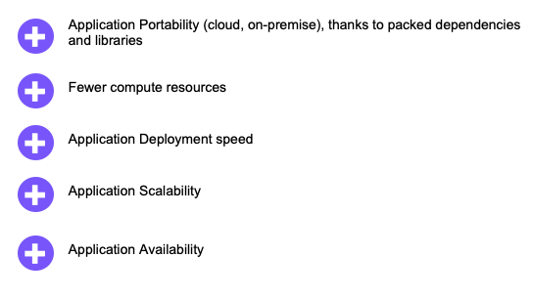
Advantages: Why do we container-ize with Kubernetes?
[Skip this slide if client audience is familiar with containers]

Slide 17
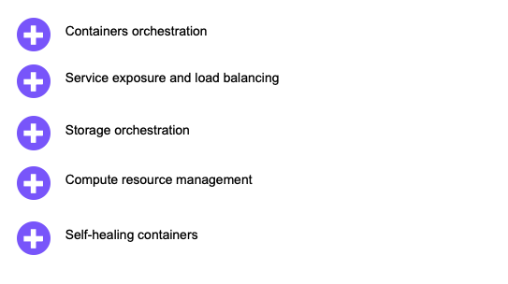
Main K8s features

Slide 18
Nutanix Kubernetes Platform (NKP) Overview
NKP Design Workshop | Confidential
Notes:
This section covers the various NKP product editions & their features, NKP components

Slide 19
Nutanix Kubernetes Platform (NKP)
NKP can be utilized for managing the full lifecycle of Kubernetes clusters on various computing platforms, such as pre-provisioned, on-premise and in-cloud infrastructure. NKP can deploy, configure, scale, upgrade and retire Kubernetes clusters. NKP is based on Cluster API (CAPI), the industry recognized best practice for Kubernetes cluster management.
NKP has multiple product editions – Starter, Pro and Ultimate – that provide varying levels of features and functionality based on their edition. The various NKP service offerings are based on these product editions. The NKP Essential service offering aligns with the NKP Starter edition, while the NKP Advanced service offering aligns with NKP Pro. Lastly the NKP Enterprise service offering aligns with the NKP Ultimate product edition.
Notes:
In the way that Kubernetes is a manager of containers, NKP is a manager of Kubernetes clusters. While NKP provides pure, upstream Kubernetes (preventing vendor ‘lock-in’), it does provide an opinionated deployment of the open-source applications that make Kubernetes usable out of the box, including full support of such components. This simplifies the deployment and maintenance of K8s clusters and provides a worry-free experience on inter-component compatibility and upgrades.
The next set of slides go into details on the various features that each NKP product edition includes

Slide 20
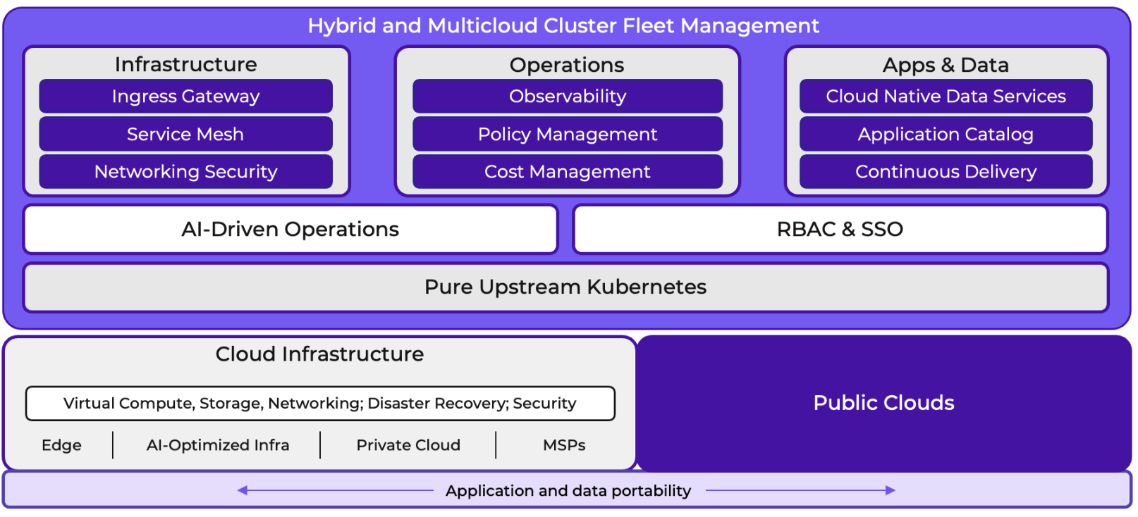
The Nutanix Kubernetes Platform (NKP)

Slide 21
NKP Editions Matrix
 | Starter | Pro | Ultimate
 | The fastest, easiest way to run Kubernetes on Nutanix | An enterprise-ready stack ready to take applications in a cluster to production | True fleet management for clusters running on premises, in the cloud, or anywhere
CSI | ✔ | ✔ | ✔
RBAC & SSO | ✔ | ✔ | ✔
Load Balancing | ✔ | ✔ | ✔
Bring-Your-Own-OS | No, Rocky Linux only* | ✔ | ✔
Runs Anywhere |  | ✔ | Includes EKS and AKS
Deployment Options | NCI | NCI, vSphere, bare metal, public cloud | NCI, vSphere, bare metal, public cloud
Observability Stack |  | ✔ | ✔
Service Mesh/Serverless |  | ✔ | ✔
Multi Vendor Support |  | ✔ | ✔
AI Navigator Chatbot |  | ✔ | ✔
NDK |  | on NCI | on NCI
Fleet Management |  |  | ✔
K8s Multitenancy & Insights |  |  | ✔
K8s Catalog & Cost Mgmt. |  |  | ✔
* Pre-built node image
Notes:
Review the type of features provided at the 3 NKP product levels – from a high level standpoint:
NKP Starter gets you quickly up & running with K8s cluster out-of-box, no need to ‘build your own’ K8s server the ‘hard way’
Only runs on Nutanix infrastructure using Nutanix provisioning method
Must use NKP provided Rocky v9.4 image for cluster nodes
NKP Pro takes NKP Starter to the next level by providing ‘Day 2’ applications to make your K8s cluster enterprise ready – such as cluster ingress, backup, and an observability stack
Can run on an supported infrastructure (outside of EKS & AKS)
Can ‘bring your own OS’ as long as it is supported on the infrastructure provider selected
NKP Ultimate extends the functionality of NKP Pro by providing multi-cluster and cost management capabilities
Includes NKP Insights for predictive analysis
Includes Kubecost for cost management

Slide 22
Product Overview
Kubernetes Management Platform based on Cluster API (CAPI) architecture.
Consistent & standard methodology for the full lifecycle management of K8s clusters:
Provisioning, Configuration, Scaling, Upgrading, Deletion
Utilizes a Kubernetes in Docker (KIND) bootstrap cluster to deploy an initial cluster.
Supported provisioning methods include:
CAPA (AWS), CAPG (Google), CAPPP (Pre-Provisioned), CAPV (vSphere), CAPX (Nutanix), CAPZ (Azure)
EKS & AKS (limited to Ultimate workload clusters)
Notes:
This slide provides a background of Cluster API (CAPI), which NKP utilizes for K8s cluster lifecycle management, and the supported provisioning/lifecycle management cloud & on-prem providers

Slide 23
NKP ‘Editions’ Overview
[Bold font of ‘edition’ to be implemented & change font color for it & its bulletpoints to purple]
NKP Starter
Kubernetes, plus…
Container runtime (containerd)
Container network & storage interface
UI for SSO integration & workload cluster deployments
NKP Pro
NKP Starter, plus…
FluxCD
Platform Apps such as backup & observability
NKP Ultimate
NKP Pro, plus…
Multi-tenancy & policy federation
UI-based CD functionality
Cost management
Predictive analytics
Notes:
Provide high-level overview of the features/functionality of each NKP product edition.
SSO is provided via Dex, an identity broker that can be used to enable authentication through a 3rd party source such as LDAP, SAML, OIDC, GitHub.
Multi-tenancy means policy management at the K8s ‘namespace’ level, thus enabling segregation of user features/authorizations within the cluster instead of at a cluster-wide level.
Application catalog enables the deployment of Kafka & Zookeeper to ‘managed’ (aka workload) clusters and provides the ability to add custom & partner applications to it.
Cost management is provided through Kubecost.
NKP Insights is used for predictive analysis of NKP clusters.

Slide 24
NKP Starter – Clusters Overview
[Remove slide if not NKP Starter]
NKP Management Cluster
Responsible for cluster lifecycle mgmt. of itself & all clusters that are deployed from it
NKP Workload (Managed) Clusters
NKP clusters deployed via an NKP mgmt. Cluster
Responsible for running K8s workloads
NKP platform applications limited to Traefik & Reloader
Notes:
NKP management cluster for the Starter edition is limited mainly to the LCM of additional NKP clusters. Traefik provides cluster ingress and Reloader syncs changes that occur to config maps & secrets on applications that are dependent upon them.

Slide 25
NKP Pro – Clusters Overview
[Remove slide if not NKP Pro]
NKP Management Cluster
Responsible for cluster lifecycle mgmt. of itself & all clusters that are deployed from it
NKP Workload (Managed) Clusters
NKP clusters deployed via an NKP mgmt. Cluster
Responsible for running K8s workloads
NKP platform application catalog available at the workspace (cluster-wide) level
Notes:
NKP management cluster for the Pro edition is limited mainly to the LCM of additional NKP clusters and the ability to deploy NKP platform applications to ‘stand-alone’ clusters it has provisioned at a cluster-wide level.

Slide 26
NKP Ultimate – Clusters Overview
[Remove slide if not NKP Ultimate]
NKP Management Cluster
Responsible for cluster lifecycle mgmt. of itself & all clusters that are attached to it
Federates policy through NKP Workspaces (cluster-level) & Projects (namespace-level)
NKP Workload (Managed) Clusters
NKP clusters deployed via an NKP mgmt. cluster
Responsible for running K8s workloads
Configuration can be dictated by NKP Workspace & Project assignments (RBAC, app deploys, config mgmt., quotas/limits)
Notes:
NKP management cluster should only host its own application workloads (ones that are part of the NKP Platform Applications/Kommander), NKP workload clusters are responsible for hosting client-based workloads. NKP policy federation is orchestrated from the NKP management cluster via the NKP UI

Slide 27
NKP Components Overview
NKP Bootstrap Cluster
KIND cluster utilized for initial NKP cluster deployment
Can be removed once the NKP cluster is deployed
NKP Control Plane Nodes
K8s mgmt. tier (etcd, kube-scheduler, etc.)
3 control planes needed for HA
NKP Worker Nodes
K8s workload processing tier
Notes:
KIND cluster stands for Kubernetes IN Docker – as part of an NKP installation, it is installed on the NKP deploy machine as a container that can run on the Docker or Podman container runtime. If an NKP cluster is deployed as ‘self-managed’ it is automatically installed (and subsequently removed) as part of the NKP cluster deployment.

Slide 28
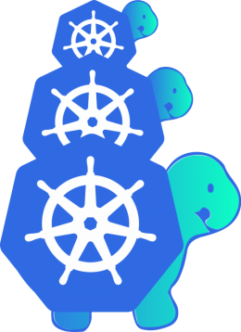

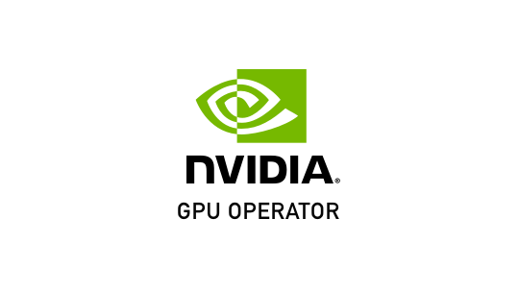



















NKP Platform Applications
K8s
Cloud-Native
Data Services
AI/ML
[Remove slide if NOT NKP Ultimate]
Cost
Management
Cluster
API
Continuous
Delivery
An enterprise-ready, pure upstream, cloud-native stack ready for production.
True portability with no lock-in.
With ML- and AI-driven operations for speed of adoption.
NKP
Policy
Management
Gatekeeper
Networking
Ingress
Gateway
Observability
Service
Mesh
Security
Storage
Notes:
Provide an overview of the open-source applications that are provided with NKP Ultimate.
Cilium is the container network interface (CNI) provided for Nutanix provisioned clusters, while all other infrastructure provisioners use Calico.

Slide 29
NKP Platform Applications
K8s
AI/ML
[Remove slide if NOT NKP Pro]
Policy
Management
Cluster
API
Delivery
An enterprise-ready, pure upstream, cloud-native stack ready for production.
True portability with no lock-in.
With ML- and AI-driven operations for speed of adoption.
Gatekeeper
NKP
Networking
Ingress
Gateway
Observability
Service
Mesh
Security
Storage
Notes:
Provide an overview of the open-source applications that are provided with NKP Pro.
●Cilium is the container network interface (CNI) provided for Nutanix provisioned clusters, while all other infrastructure provisioners use Calico.
●The default container storage interface (CSI) provided by NKP is dependent upon the infrastructure provisioner used – for Nutanix, it is the Nutanix volume CSI.
●FluxCD & Helm can be utilized for application delivery and GitOps principles

Slide 30
NKP Requirements
NKP Design Workshop | Confidential
Notes:
This section covers infrastructure & component pre-reqs, including software and system resources needed for the various NKP components/editions

Slide 31
NKP Requirements
[Remove slide if not NKP Starter]
Nutanix Infrastructure
Nutanix Prism Central 2024.1+
AOS 6.5, 6.8+
NKP-provided Rocky 9.5 OS image
NKP Deploy Machine
Container runtime (Docker or Podman)
NKP installer source
Local Registry
NKP image repository (if air-gapped env.)
Valid Access & Service Accounts
Ability to generate and configure instances on Nutanix infrastructure
OIDC bind account for end-user authentication
Notes:
NOTE: NKP Starter is limited to using a NKP provided Rocky prepped image for cluster nodes & can only be provisioned on Nutanix infrastructure using the Nutanix provisioning method (CAPX).

Slide 32
NKP Management Cluster Minimum System Resources
[Remove slide if not NKP Starter]
NKP Deploy Machine
2 vCPUs, 8GB RAM
125 GiB disk
3 Control Planes
2 vCPUs, 8GB RAM
80 GiB disk in ‘/var/lib’ for containerd & kubelet
2 Worker Nodes
4 vCPUs, 8GB RAM
80 GiB disk in ‘/var/lib’ for containerd & kubelet
Cluster-wide Storage (for PV usage)
~15 GiB formatted disk (of varying sizes)
Notes:
The minimum recommended number of worker nodes for an NKP cluster is 3 to address HA considerations in case of a worker node failure. The actual number of worker nodes that should be implemented is dependent upon the resource requirements of the applications that are expected to be deployed onto the cluster. If

Slide 33
NKP Management Cluster Network Requirements
[Remove slide if not NKP Starter]
Highly Recommended
No port/traffic restriction between NKP cluster nodes
Additional IP Addresses
1 within same subnet as control planes for control plane HA
1 within same subnet as worker nodes for NKP application ingress

Slide 34
NKP Workload or Stand-Alone Cluster Minimum System Resources
[Remove slide if not NKP Starter]
3 Control Planes
4 vCPUs, 12GB RAM
80 GiB disk in ‘/var/lib’ for containerd & kubelet
3 Worker Nodes
8 vCPUs, 12GB RAM
80 GiB disk in ‘/var/lib’ for containerd & kubelet
Cluster-wide Storage (for PV usage)
~15 GiB formatted disk (of varying sizes)
More may be needed (dependent on needs of workloads to be deployed to cluster)
Notes:
The minimum recommended number of worker nodes for an NKP cluster is 3 to address HA considerations in case of a worker node failure. The actual number of worker nodes that should be implemented is dependent upon the resource requirements of the applications that are expected to be deployed onto the cluster.

Slide 35
NKP Workload or Stand-Alone Cluster Network Requirements
[Remove slide if not NKP Starter]
Highly Recommended
No port/traffic restriction between NKP cluster nodes
Additional IP Addresses
1 within same subnet as control planes for control plane HA
1 within same subnet as worker nodes for NKP application ingress
More may be needed in same subnet as worker nodes (dependent on needs of workloads to be deployed to cluster)

Slide 36
NKP Management Cluster Minimum System Resources
[Remove slide if not NKP Pro]
NKP Deploy Machine
2 CPUs, 8GB RAM
125 GiB disk
3 Control Planes
4 CPUs, 16GB RAM
80 GiB disk in ‘/var/lib’ for containerd & kubelet
4 Worker Nodes
8 CPUs, 32GB RAM
100 GiB disk in ‘/var/lib’ for containerd & kubelet
Cluster-wide Storage (for PV usage)
~15 – 200 GiB disk of varying sizes
Dependent upon NKP Platform Apps to be installed

Slide 37
NKP Management Cluster Network Requirements
[Remove slide if not NKP Pro]
Highly Recommended
No port/traffic restriction between NKP cluster nodes
Additional IP Addresses
1 within same subnet as control planes for control plane HA
1 within same subnet as worker nodes for cluster ingress

Slide 38
NKP Workload or Stand-Alone Cluster Minimum System Resources
[Remove slide if not NKP Pro]
3 Control Planes
4 CPUs, 16GB RAM
80 GiB disk in ‘/var/lib’ for containerd & kubelet
3 Worker Nodes (4 if Rook-Ceph is needed)
8 CPUs, 32GB RAM
100 GiB disk in ‘/var/lib’ for containerd & kubelet
Cluster-wide Storage (for PV usage)
~15 – 200 GiB disk of varying sizes
Dependent upon NKP Platform Apps to be installed
More may be needed (dependent on needs of workloads to be deployed to cluster)

Slide 39
NKP Workload or Stand-Alone Cluster Network Requirements
[Remove slide if not NKP Pro]
Highly Recommended
No port/traffic restriction between NKP cluster nodes
Additional IP Addresses
1 within same subnet as control planes for control plane HA
1 within same subnet as worker nodes for NKP application ingress
More may be needed in same subnet as worker nodes (dependent on needs of workloads to be deployed to cluster)

Slide 40
NKP Management Cluster Minimum System Resources
[Remove slide if not NKP Ultimate]
NKP Deploy Machine
2 CPUs, 8GB RAM
125 GiB disk
3 Control Planes
4 CPUs, 16GB RAM
80 GiB disk in ‘/var/lib’ for containerd & kubelet
4 Worker Nodes
8 CPUs, 32GB RAM
100 GiB disk in ‘/var/lib’ for containerd & kubelet
Cluster-wide Storage (for PV usage)
~15 – 200 GiB disk of varying sizes
Dependent upon NKP Platform Apps to be installed

Slide 41
NKP Management Cluster Network Requirements
[Remove slide if not NKP Ultimate]
Connectivity to NKP Workload Clusters
For NW restricted access, a ‘kube-tunnel’ can be implemented
Highly Recommended
No port/traffic restriction between NKP cluster nodes
Additional IP Addresses
1 within same subnet as control planes for control plane HA
1 within same subnet as worker nodes for cluster ingress

Slide 42
NKP Workload Cluster Minimum System Resources
[Remove slide if not NKP Ultimate]
3 Control Planes
4 CPUs, 16GB RAM
80 GiB disk in ‘/var/lib’ for containerd & kubelet
3 Worker Nodes (4 if Rook-Ceph is needed)
8 CPUs, 32GB RAM
100 GiB disk in ‘/var/lib’ for containerd & kubelet
Cluster-wide Storage (for PV usage)
~15 – 200 GiB disk of varying sizes
Dependent upon NKP Platform Apps to be installed
More may be needed (dependent on needs of workloads to be deployed to cluster)

Slide 43
NKP & K8s Guidelines Cluster Sizing
NKP Clusters
Max of 5 control planes per cluster
Max of 75 workload clusters per management cluster
Max of 200 worker nodes per cluster
K8s Pods
Default max of 110 pods per node
Can be increased upwards of 250 pods per node

Slide 44
Solution Requirements Gathering
NKP Design Workshop | Confidential
Notes:
Gather information on client history as it pertains to the engagement – current container environment, how to get from there to NKP, any painful lessons paid to be aware of and avoid, etc.

Slide 45
Current State Analysis
History lesson or how did we get here?
Understanding the problem
What problem are we trying to resolve?
Have any attempts been made to solve the issue?
Is anything impeding progress?
Notes:
Understanding the customer’s environment provides insight into future design decisions, potential things to avoid or take note of as concerns, priorities, etc. Document all this information.
Are there problems business, technical or both?
What has prevented the problem from being solved before this? - Time - Resourcing - Skillsets - Other

Slide 46
Current State Analysis
Review existing container platform and strategy
Review application stack
Review network
Review load balancing
Review management tools\processes
Notes:
Any existing container/K8s environments? Is this a migration effort? If so:
What needs migrated?
What type of migration strategy is needed (i.e., can there be downtime, are there enough resources to run environments in parallel for at least a short period of time, etc.)?
Is there persistent data to be migrated?
Identity applications/workloads to be implemented/migrated
System resource requirements (to help determine cluster sizing)
Storage requirements (if persistent)
Ingress requirements
Network considerations
Other pre/co-requisites?
Any other pertinent design/configuration considerations?

Slide 47
Business and Technical Requirements
Design Elements for Requirements
Performance – How the solution meets performance expectation
Scalability – How the platform scales to meet current and future needs
Availability – How the solution meets business SLAs
Manageability – How the solution is managed operationally
Recoverability – How the solution can be recovered during a disaster
Security – How the platform is secured and meets compliance
Notes:
As you progress through the design workshop, it's likely that more requirements will be identified. Whiteboard each requirement, and track each with a unique number. You can split requirements into business and technical, and then further divide into non-functional vs functional
Performance – what are the system resource needs of the workloads to be running in the NKP environment?
Scalability – what are the known future short-term & long-term resource requirements for existing & new NKP clusters planned to be implemented? Should they be addressed with current cluster(s) to be deployed or just noted as future needs?
Availability – identify HA/redundant capabilities of control plane & worker node tiers & what how they will be implemented to help address them (node quantities, subnet disbursement, etc.)
Manageability – review access types and details of NKP solution (NKP deploy & end-user machines, NKP management & tokens UI, platform application dashboards)
Recoverability – what are the DR requirements for the solution (e.g. Velero backup, hot standby) – note that the standard ‘deploy’ offering may not include the deploy effort for such design unless custom work efforts are included in it
Security – review security related configurations for NKP such whether or not the cluster will be air-gapped, if it needs to be FIPS compliant and whether or not STIG policies should be implemented – note most OS types do NOT support FIPS at this time and STIG configuration is not part of a standard deployment offering

Slide 48
Environment Overview
Datacenters and Sites
Networking considerations
Resource considerations
Provisioning infrastructure (per site)
Intended provider type(s)
Single / multi-cluster
OS versions (if applicable)
Resource considerations
NKP Cluster Configuration (per cluster)
Intended environments
OS platform & version
Connected or air-gapped
DevOps repos (e.g., GitOps)?
Integrations (e.g., centralized monitoring)?
Workload considerations – node pools, node selectors, labels, taints/tolerations, GPUs?
NKP configuration considerations – FIPS? STIG? Proxy?
Notes:
Understanding the customer’s existing environment & intended NKP environment provides insight into future design decisions. Document all this information.
Where all is NKP being deployed? Will these be managed or independent clusters? How many NKP environments are intended (e.g., test, dev, prod, DR, etc)? How many NKP management environments?
What kind of communication is allowed within & between NKP clusters?
What type of infrastructure provisioners will be utilized (e.g. Nutanix? AWS? vSphere?) – note only NKP Ultimate support multi-provisioner environments, and NKP Starter is limited to the Nutanix provisioning method
What OS version will be utilized for cluster nodes?
What workloads will be running where? Will there be special considerations such as node pools, workload isolation, GPUs?
Any special installation considerations? Air-gapped environment? FIPS or STIG needed? HTTP proxied env?

Slide 49
Workload Deep Dive
Application / Pods Details (it will be necessary to inventory each application for analysis)
How many applications (pods) will be running on each NKP cluster, in each environment?
Specific to each application:
What K8s objects does it consist of (e.g., pods, services, ingress, etc.)?
What system resources are needed (in terms of CPU & memory)?
What is the Service-Level-Agreement (SLA) for availability of applications (pods)?
Is external ingress needed?
Is it stateful, and if so, what are its storage needs?
Will there be a migration, or will it be greenfield?
If a migration, are there persistent data considerations? Uptime considerations?
What CI & CD solution is used?
What is the required API-Performance?
What is the required ETCD-Performance?
What is the External Load Balancer solution used?

Slide 50
Constraints, Assumptions & Risks
Identify Potential Impacts to Engagement
Timelines
Risks
Limitations
Etc.
Notes:
Identify potential impacts to project such as desired client timelines, blockers to identified client objectives & reason why (e.g., outside of scope? Licensing issue? Product limitation? Infrastructure/pre-req readiness concerns?)

Slide 51
Solution Design
NKP Design Workshop | Confidential

Slide 52
Design Considerations
CAPI Provisioning Method
E.g.: CAPA, CAPX, CAPZ
Cluster Node OS Platform & Version*
E.g.: RHEL 8.8, Ubuntu 22.04
Deploy Machine CRI
E.g.: Docker or Podman
Cluster security posture & deploy config
Air-gapped?
HTTP Proxies?
FIPS?
STIG?
Node sizing?
Specific node pools?
Persistent data needs?
*NKP Starter edition limited to pre-set Rocky 9.5 image
Notes:
<***********This should be part of the requirements gathering. It then leads us to the design decisions that help guide us to design itself.****************>
Identify & note any design considerations that can be made at this time, such as infrastructure provisioning method(s), cluster worker node scaling, cluster installation configuration, etc.
Depending on the complexity of the environment and whether or not all the necessary information has been able to be gathered from the discovery session(s), a number of decisions may be undetermined at this point, such as worker node quantity & sizing.

Slide 53
Next Steps
Engagement Team
Responsibilities & contact info
Project Timelines
Project Schedule ETA
Solution Design ETA
Configuration Workbook ETA
Project Closeout ETA
Deployment Kickoff ETA (if applicable)
Project Cadence & Correspondence
Project Status Calls/Reports
Further Working Sessions (if applicable)
Notes:
Provide information on next steps & ETAs for them, identify project cadence, team contact info, and any follow up working sessions, if needed.

Slide 54
References
NKP Design Workshop | Confidential

Slide 55
References
NKP Online Documentation https://portal.nutanix.com/page/documents/details?targetId=Nutanix-Kubernetes-Platform-v2_12:Nutanix-Kubernetes-Platform-v2_12
NKP Release Notes
https://portal.nutanix.com/page/documents/details?targetId=Release-Notes-Nutanix-Kubernetes-Platform-v2_12:Release-Notes-Nutanix-Kubernetes-Platform-v2_12
CAPI Architecture https://cluster-api.sigs.k8s.io/
Kubernetes Documentation https://kubernetes.io/docs/home/
Kubernetes Containers
https://kubernetes.io/docs/concepts/containers/

Slide 56
Thank you
NKP Design Workshop | Confidential

